Slide 1
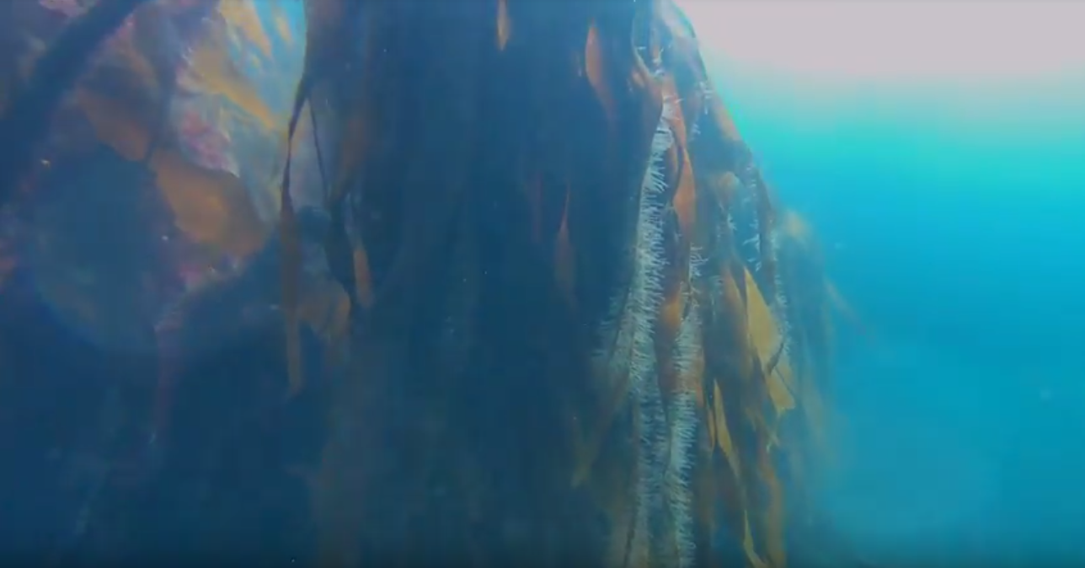
Palmaria palmata
Laminaria sp.
unidentified epiphytes

Slide 2
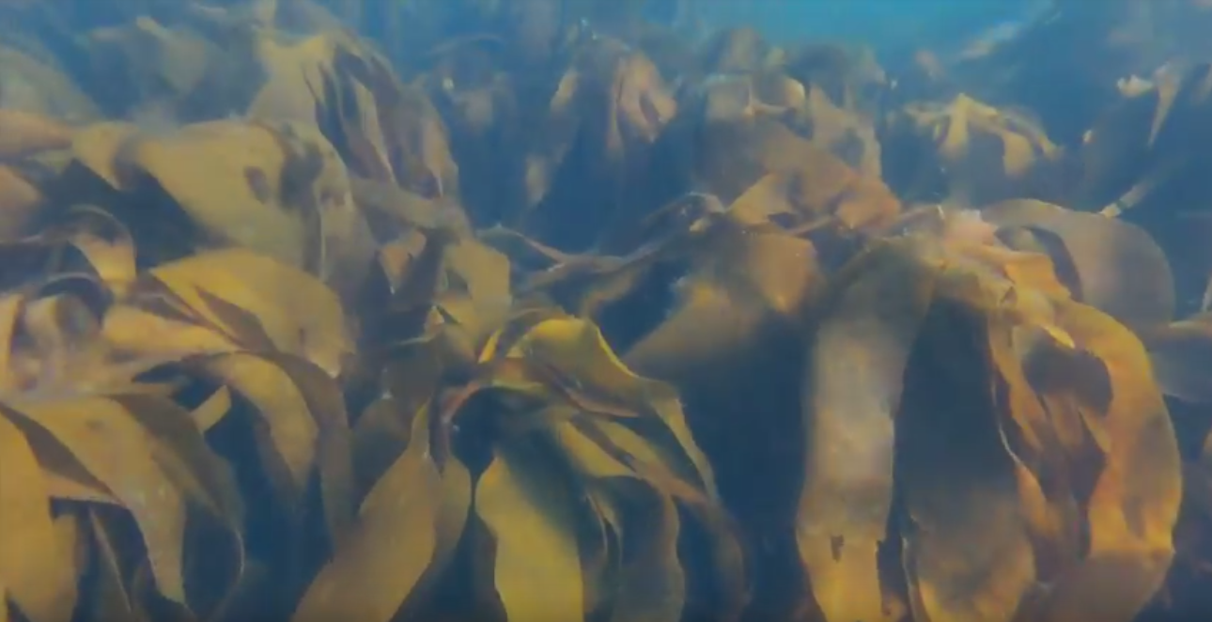
Laminaria hyperborea
Laminaria digitata

Slide 3
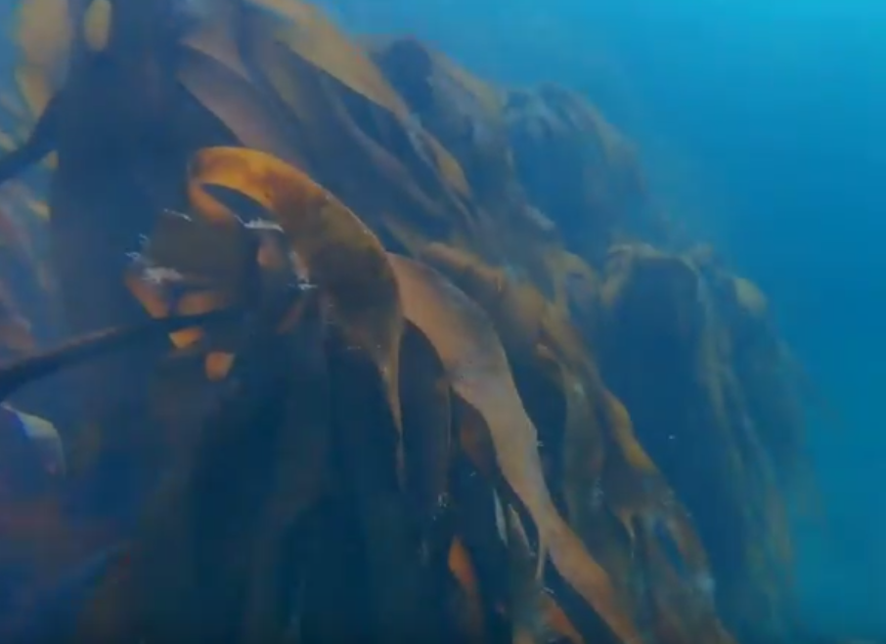

Slide 4
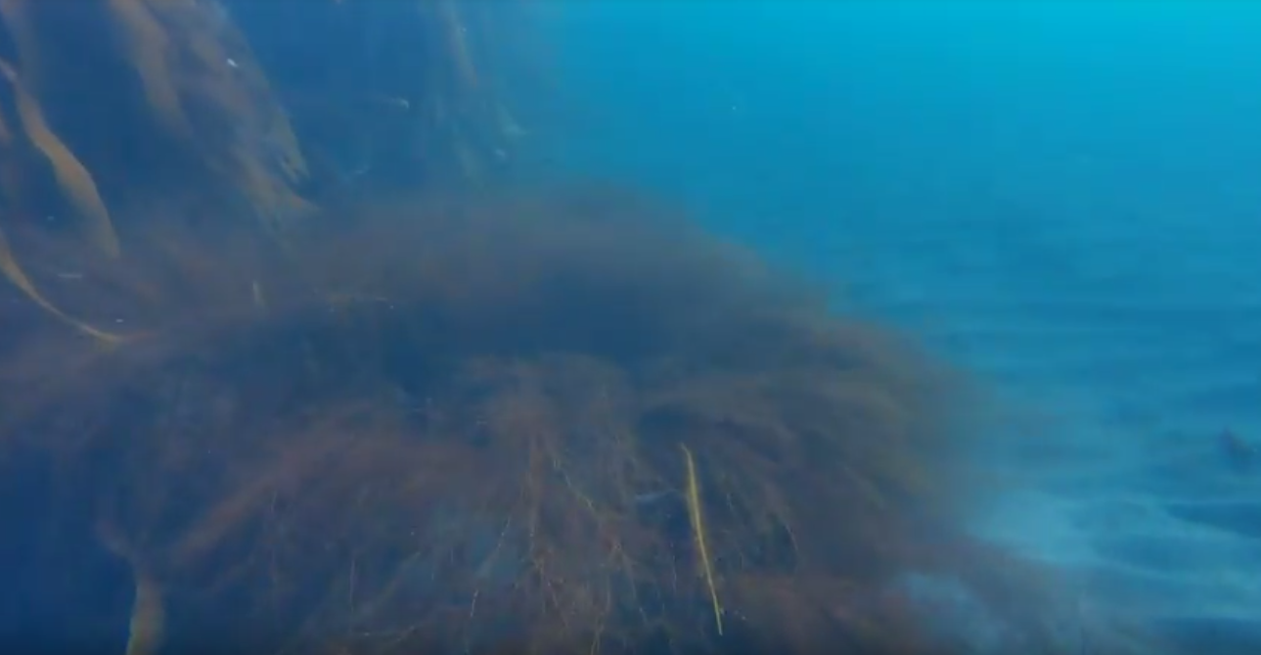
Laminaria sp.
(Himanthalia elongata)
Alaria esculenta

Slide 5
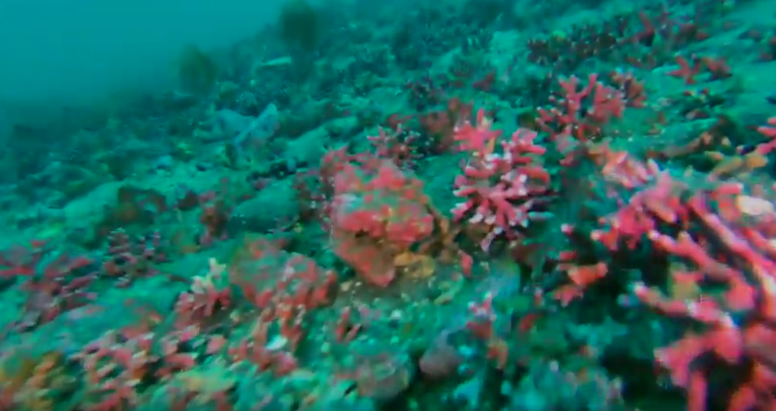
Ulva lactuca
Corallinaceae – (Hormathia sp.)

Slide 6
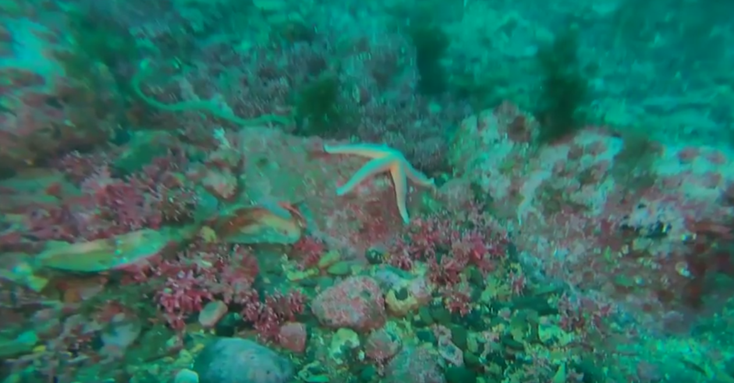
Ulva lactuca
Corallinaceae
(Lithophyllum sp.)
Corallinaceae
(Hormathia sp.)

Slide 7
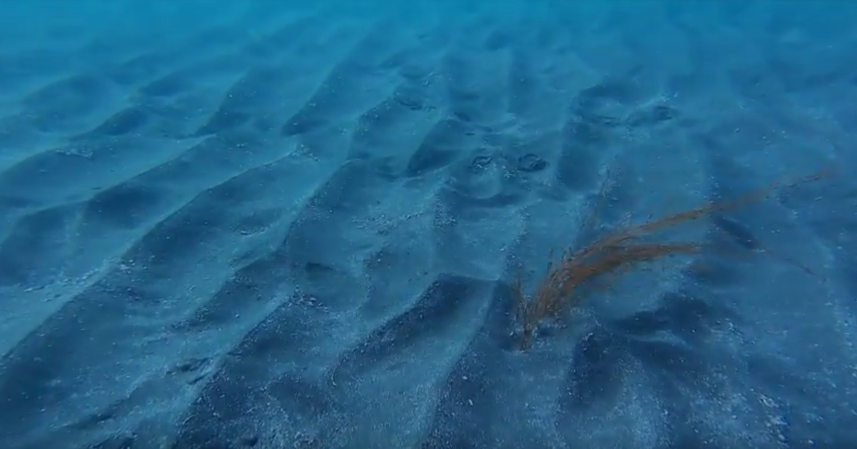
faecal strings of Arenicola marina
(Himanthalia elongata)

